Slide 1

Home automation using IoT

Slide 2
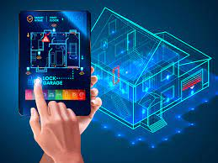
What is Home automation?
Home automation is building automation for a home, called smart home or smart house.
A home automation system will monitor
and/or control home attributes such as lighting, climate, entertainment systems, and appliances.
It may also include home security such as
access control and alarm systems.
It typically connects controlled
devices to a central hub or "gateway".

Slide 3
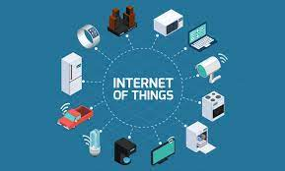
What is IoT?
The Internet of Things (IoT) refers to a vast number of “things” that are connected to the internet so they can share data with other things.
Internet-connected devices use built-in sensors to collect data and, in some cases, act on it.
Real-world Internet of Things examples range from a smart home that automatically adjusts heating and lighting to a smart factory that monitors industrial machines to look for problems, then automatically adjusts to avoid failures.

Slide 4
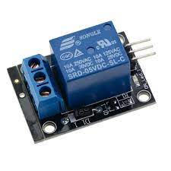
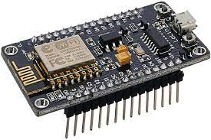
Hardware used
NodeMCU ESP8266 WiFi microcontroller:
NodeMCU is an open-source Lua based firmware and development board specially targeted for IoT based Applications.
It includes firmware that runs on the ESP8266 Wi-Fi SoC from Espressif Systems, and hardware which is based on the ESP-12 module.
2. 5V Relay module:
A relay is an electrical device which is generally used to control high voltages using very low voltage as an Input.
Whenever an electricity is passed through the coil, it creates a magnetic field and attracts the moving node towards the static node and the circuit gets completed.

Slide 5
Softwares used:
Arduino IDE:
This is a IDE that is used to write programs for most of the microcontrollers. It is based on the concept of OOPs.
We have used it do write program for NodeMCU WiFi microcontroller.
Blynk mobile application:
Blynk was designed for the Internet of Things. It can control hardware remotely, it can display sensor data, it can store data, visualize it and do many other cool things.
We have used it to control the tubelight.
Java development kit:
OpenJDK (Open Java Development Kit) is a free and open-source implementation of the Java Platform, Standard Edition (Java SE).
We have used it to run the local blynk server’s .jar(Java Archive) file.

Slide 6
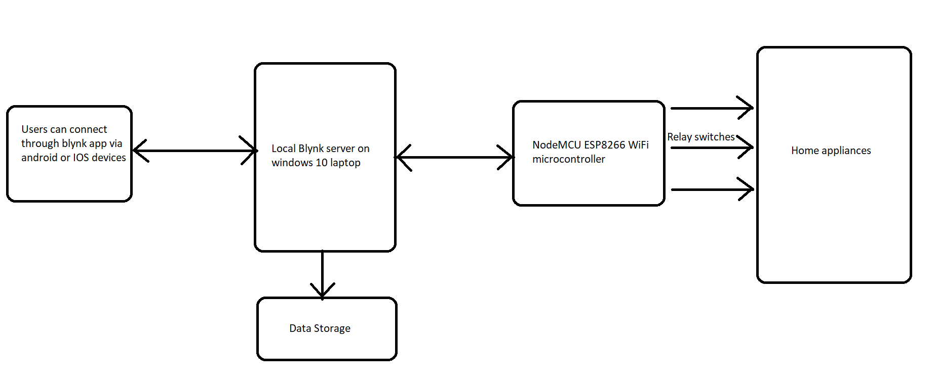
Block diagram:

Slide 7
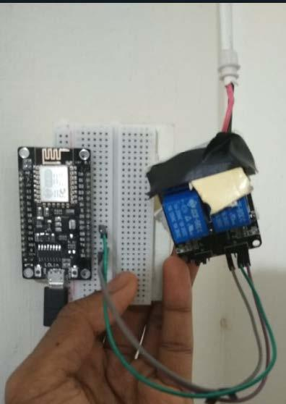
Implementation:
We have used relay as a high voltage switch to switch on and off the tubelight. The nodemcu WiFi microcontroller is connected to blynk server which establishes communication via mobile from any part of the world.
The microcontroller’s code is included with a unique auth token which is also present in mobile device. It is also included with the IP address of the laptop(where server is hosted).
The local blynk server should be running in the command prompt.
The IP address and the http port(where the blynk server can communicate) should be specified in mobile device.
The data of users logging in can be monitored.

Slide 8
Code:
#include <BlynkSimpleEsp8266.h>
char auth[] = "y6qhdQsR0QCk97egqsrV4xuWL22FDU2D";
char ssid[] = "SURAG 2G";
char pass[] = "9886343789";
void setup()
{
Serial.begin(9600);
Blynk.begin(auth, ssid, pass, IPAddress(192,168,29,116),8088);
}
void loop()
{
Blynk.run();
}

Slide 9

Problems faced:
Tried port forwarding to make the local blynk server accessible to outside of its network(LAN). But jio fiber doesn’t allow the option.

Slide 10

Future scope and improvements of our project
The system can be improved upon to convert entire home into a smart home.
The system can also be implemented for various security applications.
Hosting a local server for any useful IoT product developed.

Slide 11

Team members:
Ajay M
Sanjan B M
Surya M S

